Slide 1
Usage of Pro bono services
Group 9:
Mohammad Noor
Apram Ahuja

Slide 2
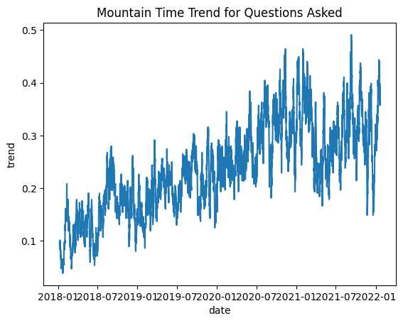
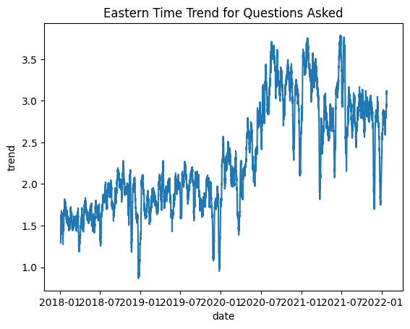
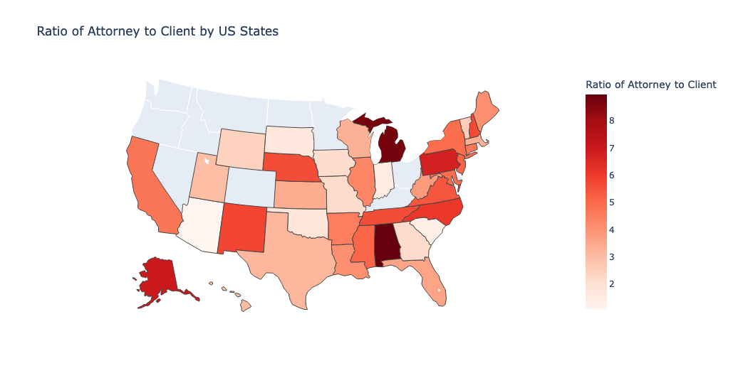
Questions Asked By States and Years
Texas and Florida has one of the lowest ratio of attorney to clients
However has one of the highest volume
In conjunction with the increasing trend of questions asked in those states over the years, we recommend increasing workforce

Slide 3
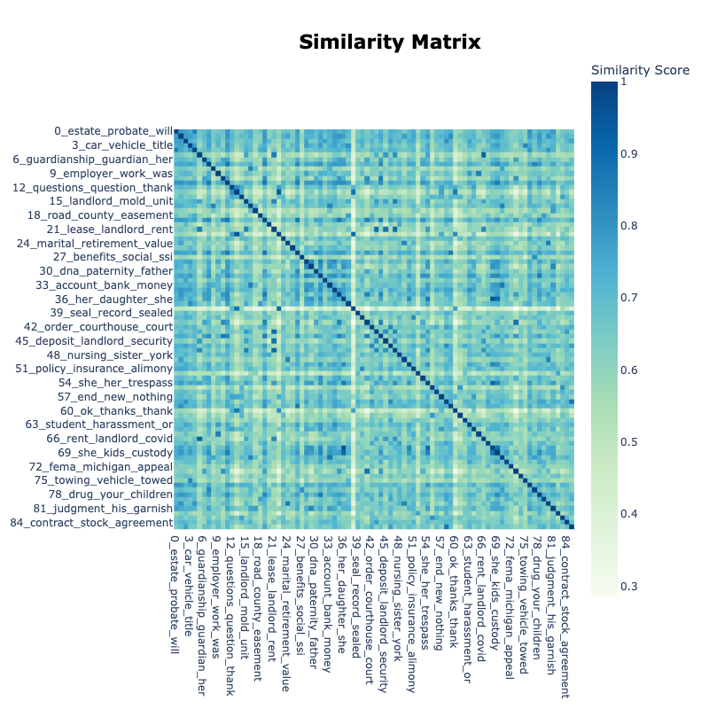
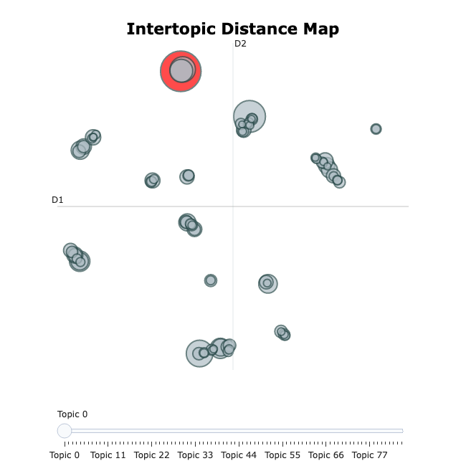
Performed topic modelling using BERTopic on question posts dataset which could classify the text into major categories.
Model provides us with around 8 major clusters which are in accordance with the categories. The website already has more than required categories so, they could possibly decrease the categories.
NLP Model on Question Posts:

